Slide 1

Quiz Quest
Group 8:
Edward Liang, Jonathon Repta, Jennifer Alonso, and Amal Syed

Slide 2
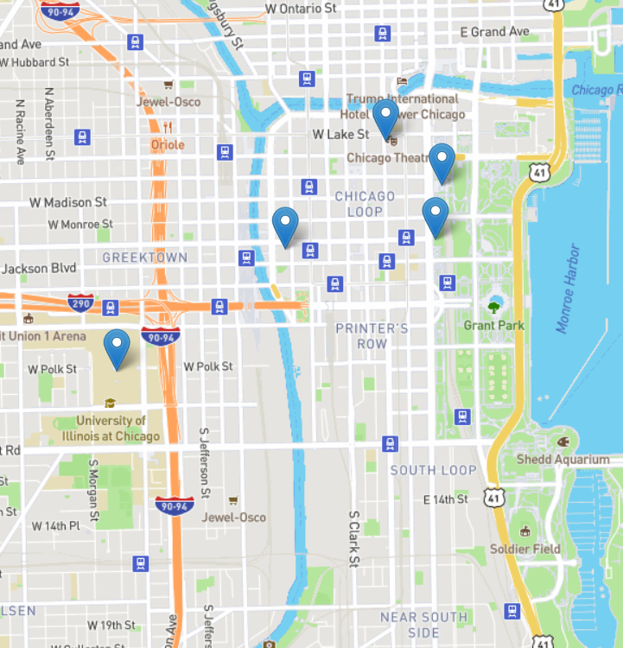
What is it?
Location based quiz game
Lets players learn about and explore new locations simultaneously
Runs in browser

Slide 3
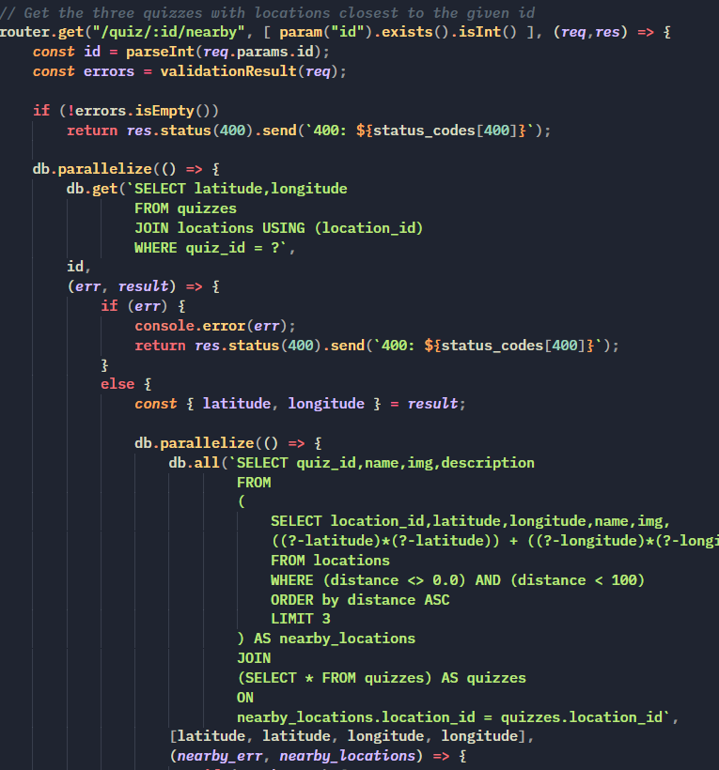
How is it implemented?
Uses Node.js for the runtime environment
Uses Express.js for the backend framework
Uses SQLite for the database
Uses Bootstrap for the frontend

Slide 4
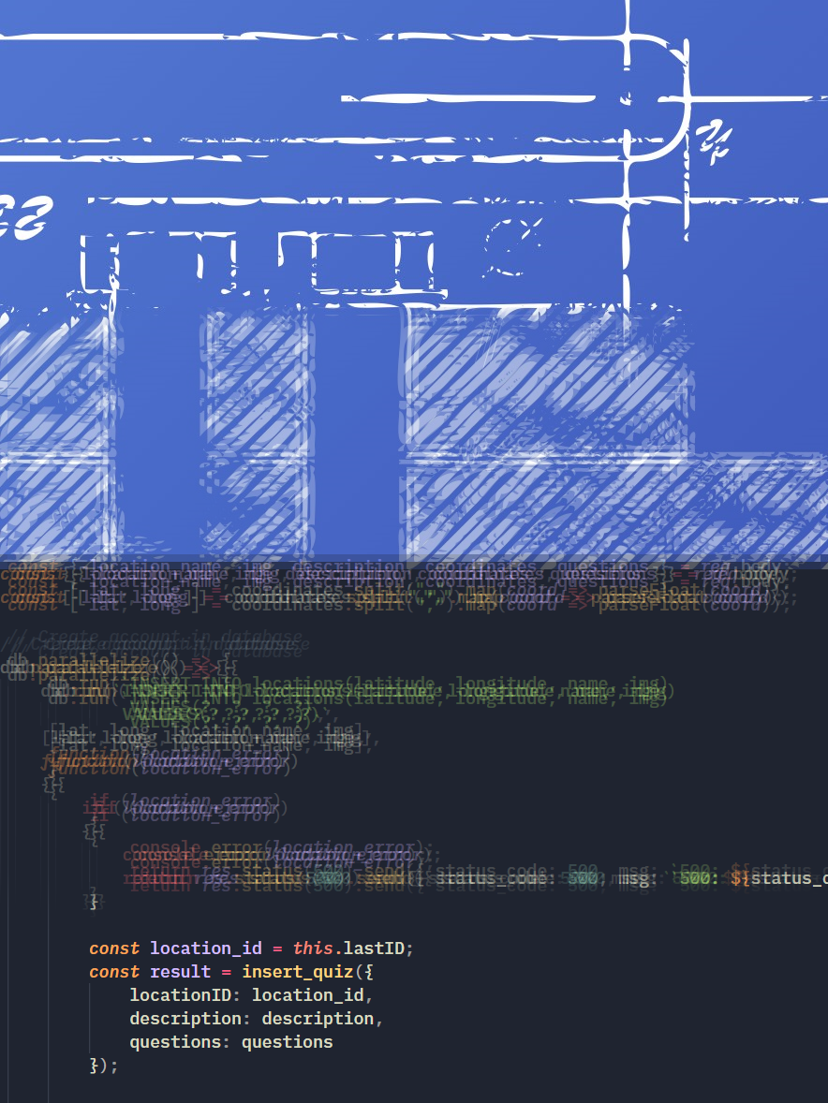
How it differs from the blueprint?
Web app, rather than a native app
Limited by JavaScript’s Geolocation API
Less emphasis on location based features

Slide 5
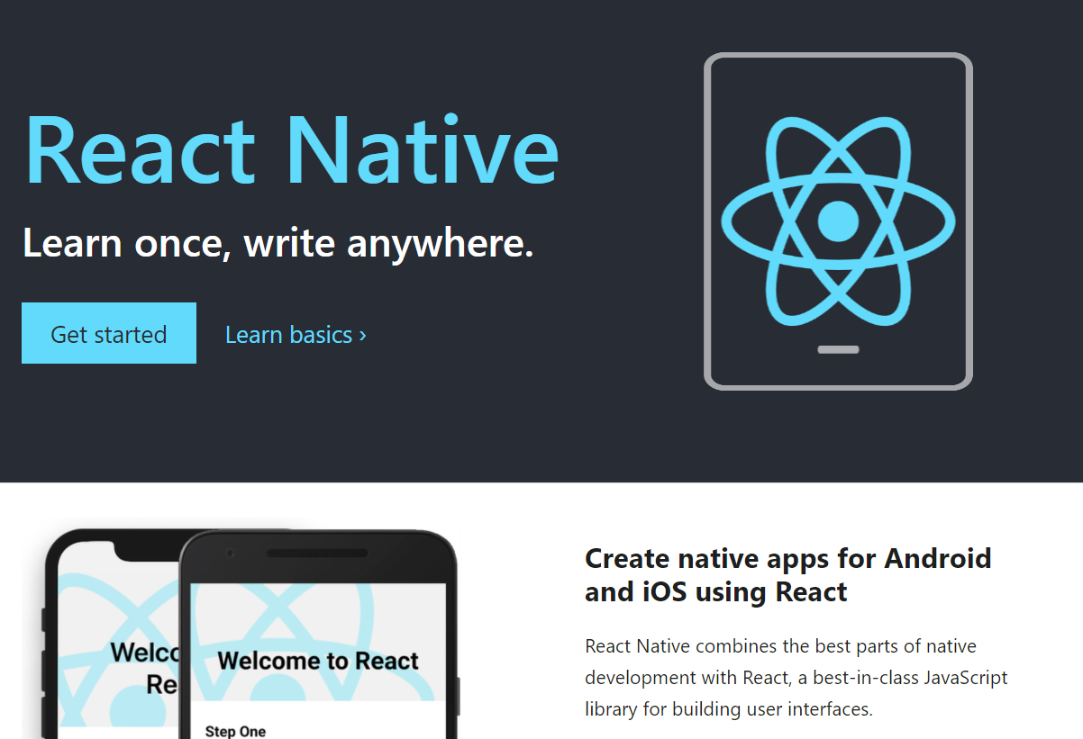
Possibilities for expansion?
Native mobile port
Emphasis of location elements
Expansion of community features

Slide 6

Acknowledgments
Anthony Nedumgottil, Tan Le, Tsz Lam, and Weiheng Ruan
Name of Project: Quiz Quest
From: Fall 2016

Slide 7
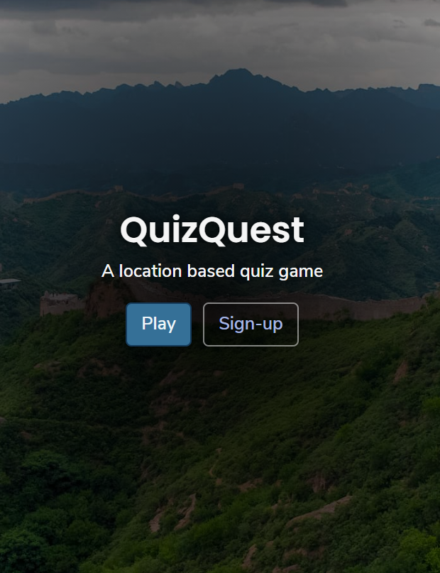
Live Code Demo
https://quiz--quest.herokuapp.com/
or
https://bit.ly/2IXsqe0

